Slide 1
Association Atlas
SOTA HACK
Michael, Martin, Joe

Slide 2
Executive Summary
Hebbian learning: ‘Neurons that fire together, wire together’
Reveal the map of associations within the brain using multimodal and high-level data
Leverage to enhance capacity to learn and understand

Slide 3
Pipeline to achieve
Dataset of anchors and corresponding EEG
Build an embedding space to represent the associativity
Record EEG from conceptual stimuli and identify highest associative anchor
Use match to generate associative device on web app

Slide 4
Hackathon Scope - Decisions
Generate a dataset to allow us to identify features which identify associative vs not associative ships/anchors
OR
Generate pipelines to run application start to finish, given a relevant dataset (as described previously)

Slide 5
What is an Embedding Space
An N-dimensional coordinate frame
Neural Nets output positions in this space
Points represented by N-dimensional vectors
Points that are close in this space are similar
Lookup table

Slide 6

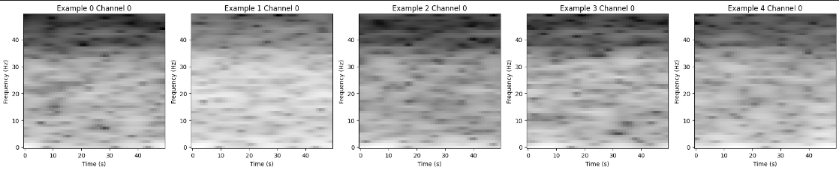
Dave and his brain
EEG brain signals
5 channels
14,012 images from ImageNet (3 seconds)
Converted to Spectrogram

Slide 7
Machine Learning
Convolutional Nets
Training methods:
Contrastive Learning
Classification
Autoencoder
BYOL
…and a transformer (insufficient compute)

Slide 8
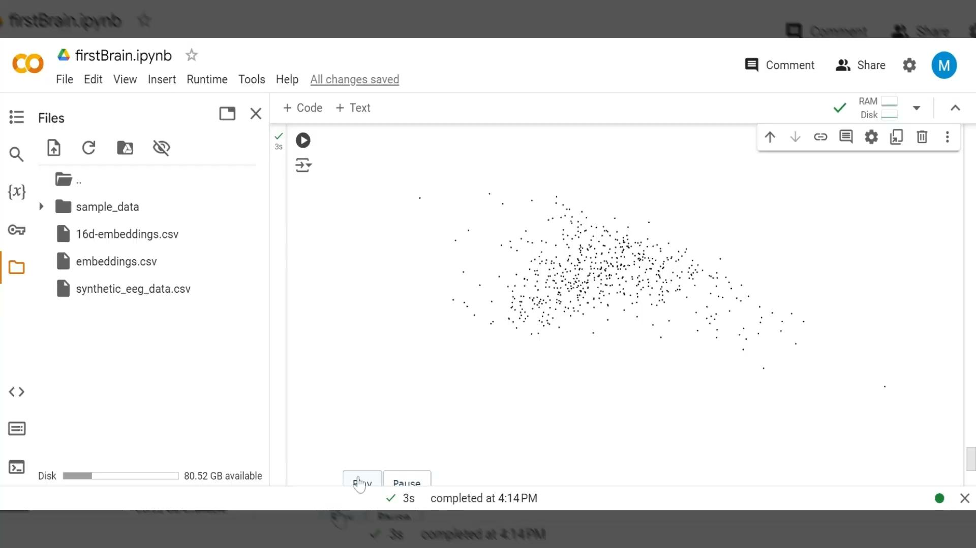


Slide 10
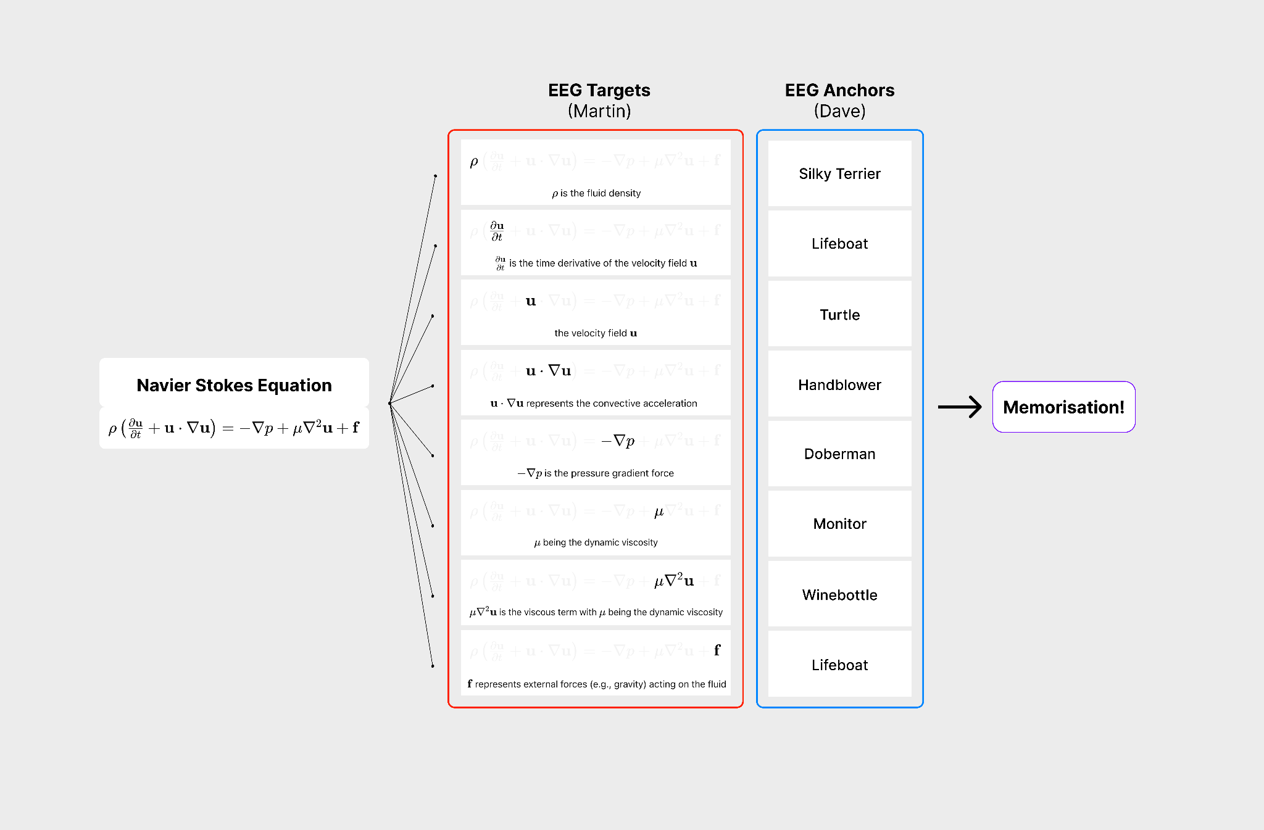

Slide 11
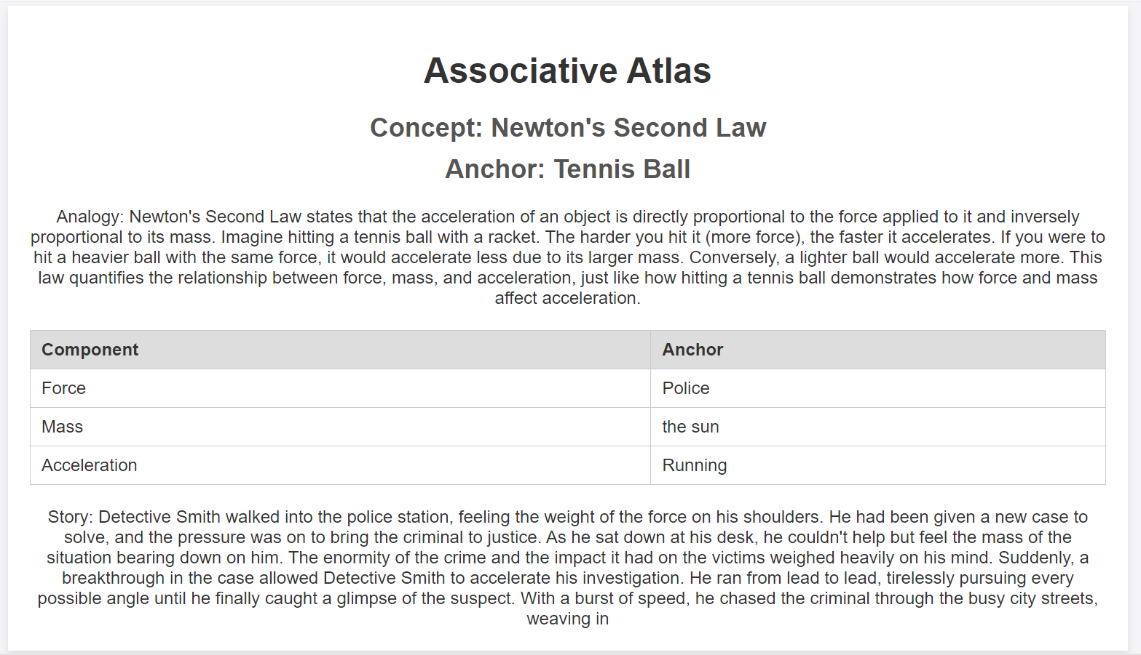
Memory Palace Web application

Slide 12
Future Progress
Variational Autoencoders / Other SSL methods for representation learning
Training NN on simultaneous Target-Anchor pairs to extract associativity from EEG
Build our own dataset
Try non-EEG modalities

Slide 13
Where can this go
Future application:
Memory
Compatibility metrics
Enhanced communication involving concept maps
Creativity (the untapped mind tree)

Slide 14
Thank you ;)
Michael, Martin, Joe

